Slide 1


JAVA Java Interview boot camp Core concepts
Lecture 20
CHAPTER 22
Collections

Slide 2
COLLECTIONS
(An easy way to manage Objects)

Slide 3

What Is A Collection ?
As the name indicates,a collection is a group of objects known as its elements. Examples of collections are :
Set of Books
List Of Names
List of phone numbers
Records Of Students
List Of e-mail id. etc

Slide 4
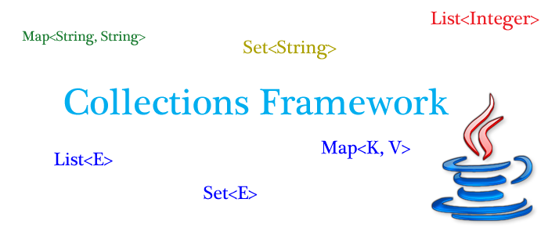
How Java supports Collections ?
To handle such collection of objects, Java offers us a huge set of predefined classes and interfaces called as
“The Collections Framework”
which is available in the package “java.util”

Slide 5
Why do we need to learn Collection ?
The first question which comes in mind of every programmer is
Why should I use Collection classes when I have an array ?
Answer:
Although arrays are very useful data storage structures but they suffer from several important drawbacks which are:
1.Remains of fixed size
2.Contains only homogeneous elements
3.No facility to add or remove elements in between

Slide 6
Advantages Of Collections
Can dynamically grow or shrink
Can contain heterogeneous or homogeneous elements
Provide predefined methods to perform all C R U D operations

Slide 7
Types Of Collections
There are 3 main types of collections:
Lists: always ordered, may contain duplicates and can be handled the same way as usual arrays
Sets: cannot contain duplicates and provide random access to their elements
Maps: connect unique keys with values, provide random access to its keys

Slide 8
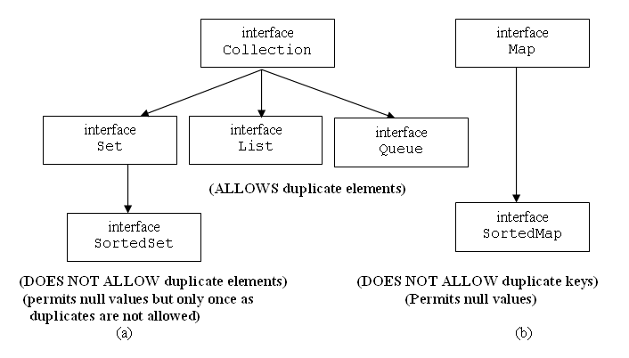
The Collection Hierarchy

Slide 9
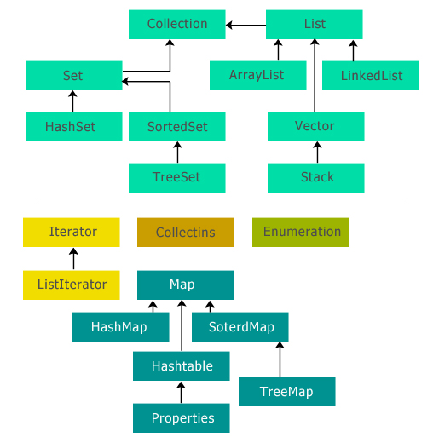
The Collection Hierarchy

Slide 10
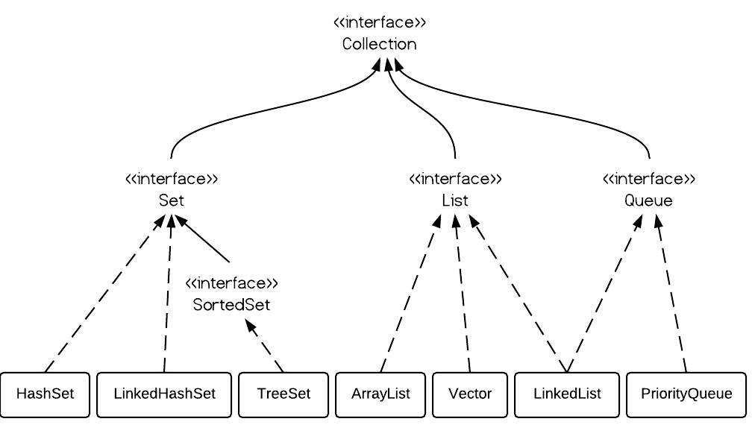
The Collection Classes

Slide 11
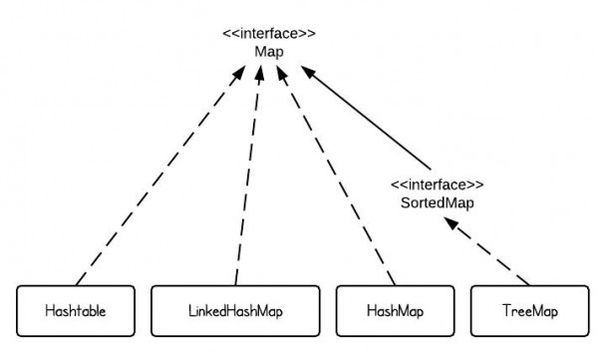
The Map Classes

Slide 12
Quiz
The core collection interfaces are organized into two distinct inheritance trees. One interface in particular is not considered to be a true Collection, and therefore sits at the top of its own tree. What is the name of this interface?
Answer: Map

Slide 13
Quiz
What interface represents a collection that does not allow duplicate elements?
Answer: Set
What interface forms the root of the collections hierarchy?
Answer: Collection

Slide 14
Quiz
What interface represents an ordered collection that may contain duplicate elements?
Answer: List
What interface represents a collection that holds elements prior to processing?
Answer: Queue

Slide 15
Quiz
How many different ways are there to iterate over the elements of a Collection.
Answer: 5
How many cursors are there to iterate over the elements of a Collection.
Answer: 3

Slide 16
Quiz
Name these cursors
Answer: Iterator, Enumeration and ListIterator
Which interface in Collections extends RandomAccess ?
Answer: None ! , It is extended by ArrayList and Vector classes

Slide 17
Quiz
What is the difference between Collection and Collections ?
Answer: First is an interface while second is a class
Which classes in Collections hierarchy are thread-safe ?
Answer: Vector,Stack,Hashtable,Properties and PriorityBlockingQueue

Slide 18
Quiz
Arrange the following in the ascending order (performance): HashMap , Hashtable , HashSet ?
Answer: Hashtable<HashMap<HashSet
Does HashSet allow null ?
Answer: Yes, but only once!

Slide 19
Quiz
Difference between HashMap and Hashtable
Answer:
HashMap | Hashtable
Not Synchronized | Synchronized
Allows null | Doesn’t allow null
Useful for Single threaded environment | Useful for multithreaded environment
Used very much | Declared as Legacy class

Slide 20
Quiz
Difference between ArrayList and LinkedList
Answer:
ArrayList | LinkedList
Backed by growable Array | Backed by Doubly Linked List
Allows random access using get() method | Does give a get() method but internally traverses from head to tail
Faster in retrieval but slower in addition and deletion | Slower in retrieval but faster in addition and deletion
Uses less memory | Uses more memory as it also maintains references to previous and next nodes

Slide 21
Quiz
Difference between HashSet and TreeSet
Answer:
HashSet | TreeSet
Maintains elements in random order | Maintains elements in sorted order
Allows null | Doesn’t allows null
Backed by HashMap | Backed by binary tree
Faster | Slower
Less functionality | Rich in functionality

Slide 22
Quiz
Which collection would you use if you needed to maintain and search on a list of parts identified by their unique alphanumeric serial number
Answer: Map

Slide 23
Quiz
18 Which collection class(es) allows you to shrink its size and provides indexed access to its elements, but whose methods are not synchronized? (Choose all that apply.)
A. java.util.HashSet
B. java.util.LinkedHashSet
C. java.util.List
D. java.util.ArrayList
E. java.util.Vector
F. java.util.PriorityQueue
Answer: D

Slide 24
Important Methods Of Collections
The Collection interface is one of the root interfaces of the Java collection classes. The general methods list of the collection interface is:
boolean add(Object obj)
void clear( )
boolean contains(Object obj)
boolean equals(Object obj)
int hashCode( )
boolean isEmpty( )
Iterator iterator( )
boolean remove(Object obj)
boolean removeAll(Collection c)
boolean retainAll(Collection c)
int size( )
Object[ ] toArray( )

Slide 25
The List Interface
The java.util.List interface is a subtype of the java.util.Collection interface and represents an ordered collection (sometimes called a sequence).
It means we can access the elements of a List in a specific order, and by an index too.
It allows duplicate objects and one or more elements to be null.
The user of this interface has precise control over where in the list each element is inserted and can access elements by their integer index (position in the list), and search for elements in the list.

Slide 26
The List Interface
The java.util.List interface is a subtype of the java.util.Collection interface and represents an ordered collection (sometimes called a sequence).
It means we can access the elements of a List in a specific order, and by an index too.
It allows duplicate objects and one or more elements to be null.
The user of this interface has precise control over where in the list each element is inserted and can access elements by their integer index (position in the list), and search for elements in the list.

Slide 27
Implementation Classes Of “List”
We can choose between the following List implementations in the Java Collections API: java.util.ArrayList java.util.LinkedList java.util.Vector java.util.Stack Here are a few examples of how to create a List instance: List listA = new ArrayList(); List listB = new LinkedList(); List listC = new Vector(); List listD = new Stack();

Slide 28
The “ArrayList” class
ArrayList implements List interface.
ArrayList capacity grows automatically.
The ArrayList is not synchronized.
It permits all elements including null.
Array lists are created with an initial size of 10
When this size is exceeded, the collection is automatically enlarged and when objects are removed, the array may be shrunk.

Slide 29
Constructors Of ArrayList
public ArrayList( )
This constructor builds an empty array list with an initial capacity of 10
public ArrayList(int capacity)
This constructor constructs an empty list with the
specified initial capacity.
public ArrayList(Collection c)
Constructs a list containing the elements of the specified
collection, in the order they are returned by the collection's
iterator.

Slide 30
Example
ArrayList fruits=new ArrayList();
fruits.add("Mango");
fruits.add("Apple");
fruits.add("Guava");
System.out.println("Contents are:"+fruits);
Output:
Contents are:[Mango, Apple, Guava]

Slide 31
Question 1
Write a program to accept 5 unique integers from the user and store them in the list if they are already not present.

Slide 32
Question 2
Write a program to accept 10 integers from the user and display how many were unique and how many were duplicate. Also display these numbers

Slide 33
Converting Array To ArrayList
We can convert an array to arraylist using following ways.
Arrays.asList() method - Pass the required array to this method and get a List object and pass it as a parameter to the constructor of the ArrayList class.
Collections.addAll() method - Create a new list before using this method and then add array elements using this method to existing list.
Iteration method - Create a new list. Iterate the array and add each element to the list.

Slide 34
Arrays.asList()
Prototype: public static List asList(T... a)
Returns a fixed-size list backed by the specified array.
The returned list is serializable and implements RandomAccess.
Since returned List is fixed-size therefore we can’t add more element in it, but we can replace existing element with new element using set(index, new Element) method defined in ArrayList class.

Slide 35
Example
String[] days={"Mon","Tue","Wed"};
List<String> daysList=Arrays.asList(days);
System.out.println(daysList);

Slide 36
Adding New Element
String[] days={"Mon","Tue","Wed"};
List<String> daysList=Arrays.asList(days);
System.out.println(daysList);
Output:
[Mon, Tue, Wed]
Exception in thread "main" java.lang.UnsupportedOperationException
Conclusion:
Since returned List is fixed-size List, we can’t add more element(s). An attempt of adding more elements would cause UnsupportedOperationException.

Slide 37
Solution
String[] days={"Mon","Tue","Wed"};
List<String>daysList=new ArrayList(Arrays.asList(days));
System.out.println(daysList);
daysList.add("Thu");
System.out.println(daysList);
Output:
[Mon, Tue, Wed]
[Mon, Tue, Wed, Thu]

Slide 38
Collections.addAll()
Prototype: public static boolean addAll(Collection c, T... a)
Adds all of the specified elements to the specified collection.
Elements to be added may be specified individually or as an array.

Slide 39
Example
String[] days={"Mon","Tue","Wed"};
ArrayList<String> daysList=new ArrayList<>();
Collections.addAll(daysList, days);
System.out.println(daysList);
daysList.add("Thu");
System.out.println(daysList);
Output:
[Mon, Tue, Wed]
[Mon, Tue, Wed, Thu]

Slide 40
Traversing ArrayList
We can traverse an ArrayList in 5 ways:
Using iterator
Using enhanced for
Using ListIterator
Using Enumeration
Using normal loop

Slide 41
Traversing ArrayList Using Iterator
An Iterator is an object that enables us to traverse through a collection
It is a Universal Cursor as it can be used to traverse any Collection.
Iterator can also be used to remove elements from the collection selectively, if desired.

Slide 42
Traversing ArrayList Using Iterator
We get an Iterator for a collection by calling its iterator( ) method as given below:
Iterator it=list.iterator( );

Slide 43
Methods Of Iterator
boolean hasNext();
Returns true if there are more elements,otherwise,
returns false.
Object next();
Returns the next element.
void remove();
Removes the current element.

Slide 44
Steps To Use Iterator
First obtain an iterator to the beginning of the collection by calling the collection's iterator( )
Set up a loop that makes a call to hasNext( ). Have the loop iterate as long as hasNext( ) returns true.
Within the loop, obtain each element by calling next( ).

Slide 45
Points To Remember
1. The method next( ) will throw an exception if there is no element to be returned . Thus it is recommended to use hasNext( ) before calling the method next( ).
2. Using iterator we can only traverse a collection once. As the iterator reaches it’s end we cannot pull it at the beginning.
3. The method remove( ) will throw an
IllegalStateException if an attempt is made to call
remove( ) that is not preceded by a call to next( ).

Slide 46
Iterator V/s Enhanced For Loop
As per Java,
We must use Iterator instead of the for-each construct when we need to:
Remove the current element.
1. The for-each construct hides the iterator, so we cannot call remove.
2. And if we call remove() method over a thread unsafe collection , then Java will throw an exception called ConcurrentModificationException
3. Therefore, the foreach construct is not usable for
filtering.

Slide 47
Iterator V/s Enhanced For Loop
As per Java,
We must use for-each instead of iterator if
1.We just need to traverse the Collection
2. We need to Iterate over multiple collections in parallel.

Slide 48
Guess The Output
List<Integer> l = new LinkedList<Integer>();
l.add(2);
l.add(3);
l.add(4);
List<Integer> s=new LinkedList<Integer>();
s.add(7);
s.add(8);
s.add(9);
for (Iterator<Integer> itr1=l.iterator(); itr1.hasNext(); )
{
for (Iterator<Integer> itr2=s.iterator(); itr2.hasNext(); )
{
if (itr1.next() < itr2.next())
{
System.out.println(itr1.next());
}
}
}
Answer:
NoSuchElementException

Slide 49
Guess The Output
List<Integer> l = new LinkedList<Integer>();
l.add(2);
l.add(3);
l.add(4);
List<Integer> s=new LinkedList<Integer>();
s.add(7);
s.add(8);
s.add(9);
for (int a:l)
{
for (int b:s)
{
if (a<b)
System.out.print(a + " ");
}
}
Answer:
2 2 2 3 3 3 4 4

Slide 50
Final Conclusion
Iterator Advantage:
Ability to remove elements from Collections.
Ability to check if there more elements or not by using hasNext().
Loop was designed only to iterate over a Collection, so if we want just to iterate over a Collection, its better to use loop such as for-Each, but if we want more that that you could use Iterator.

Slide 51
Drawbacks Of Iterator
Traverses only in forward direction.
Allows reading and removing but not replacing the value
Doesn’t allow adding new values

Slide 52
Using ListIterator
A ListIterator is an iterator for lists that allows the programmer to :
traverse the list in either direction i.e it is a bidirectional cursor
modify the list during iteration i.e. removing,replacing and adding
obtain the iterator's current position in the list

Slide 53
Traversing ArrayList Using ListIterator
We get an ListIterator for a collection by calling its listIterator( ) method as given below:
ListIterator lt=list.listIterator( );

Slide 54
Methods Of ListIterator
public boolean hasNext()
Returns true if there are more elements,otherwise,
returns false.
public Object next()
Returns the next element. A NoSuchElementException is thrown if
there is not a next element.
public int nextIndex()
Returns the index of the next element. If there is not a next
element, returns the size of the list.

Slide 55
Methods Of ListIterator
public boolean hasPrevious()
Returns true if there is a previous element. Otherwise, returns false.
public Object previous()
Returns the previous element. A NoSuchElementException is
thrown if there is not a previous element.
public int previousIndex()
Returns the index of the previous element. If there is not a previous
element, returns -1.

Slide 56
Methods Of ListIterator
public void remove();
Removes the current element from the list. An
IllegalStateException is thrown if remove( ) is called before next( ) or
previous( ) is invoked.
public void set(Object obj)
Assigns obj to the current element. This is the element last
returned by a call to either next( ) or previous( ).
public void add(Object obj)
Adds a new object in the list

Slide 57
Iterator V/s ListIterator
With Iterator we can move only forward, but with ListIterator we can move back word also while reading the elements.
With ListIterator we can obtain the index at any point while traversing, which is not possible with iterators.
With Iterator we can check only for next element available or not, but in ListIterator we can check previous and next elements.

Slide 58
Iterator V/s ListIterator
With Listiterator we can add new element at any point of time, while traversing which is not possible with Iterator.
With Listiterator we can modify an element while traversing, which is not possible with Iterator.

Slide 59
Very Important Points
ListIterator in Java provides an add(E e) method which is not there in Iterator. The method add(E e) inserts the specified element into the list (optional operation).
The element is inserted immediately before the element that would be returned by next(), if any, and after the element that would be returned by previous(), if any.

Slide 60
Very Important Points
ListItearator also provides a method called set(E e) which replaces the last element returned by next() or previous() with the specified element (optional operation).
But, this call can be made only if neither remove() nor add(E) have been called after the last call to next() or previous().

Slide 61
Very Important Points
ListItearator is fail-fast and throws a ConcurrentModificationException if the underlying collection is structurally modified in any way except through the iterator's own remove() or add() methods.

Slide 62
The “LinkedList” class
LinkedList implements List interface.
Uses Doubly Linked List internally.
The LinkedList is not synchronized.
It permits all elements including null.
No initial capacity, capacity/size increases as elements are added

Slide 63
The “LinkedList” class
Insertion order is preserved
Heterogeneous elements allowed
Duplicates are allowed
Implements Serializable,Cloneable but not RandomAccess. Also implements Dequeue interface
Good choice when frequent operations are adding and removing and worst when frequent operation is retrieval

Slide 64
Constructors Of LinkedList
public LinkedList( )
This constructor builds an empty list
public LinkedList(Collection c)
Constructs a list containing the elements of the
specified collection, in the order they are returned by
the collection's iterator.

Slide 65
Example
LinkedList fruits=new LinkedList();
fruits.add("Mango");
fruits.add("Apple");
fruits.add("Guava");
System.out.println("Contents are:"+fruits);
Output:
Contents are:[Mango, Apple, Guava]

Slide 66
Traversing LinkedList Using Iterator
LinkedList fruits=new LinkedList();
fruits.add("Mango");
.
.
Iterator it=fruits.iterator();
while(it.hasNext())
{
String fruit=(String)it.next();
System.out.println(fruit);
}

Slide 67
Traversing LinkedList Using ListIterator
Write the code to traverse the given list backwards ?
LinkedList fruits=new LinkedList();
fruits.add("Mango");
.
.
ListIterator it=fruits.listIterator();
for(;it.hasNext();it.next());
while(it.hasPrevious())
{
String fruit=(String)it.previous();
System.out.println(fruit);
}

Slide 68
Some special methods of LinkedList
Since LinkedList class implements the Dequeue interface so it provides us some very useful methods not provided by any other List class.
These are:
public void addFirst(Object item): It adds the item (or element) at the first position in the list.
public void addLast(Object item): It adds the item (or element) at the last position in the list.
public Object getFirst(): Returns the item (or element) at the first position in the list.

Slide 69
Some special methods of LinkedList
public Object getLast(): Returns the item (or element) at the last position in the list.
public Object removeFirst(): It removes the first item from the list.
public Object removeLast(): It removes the last item of the list.

Slide 70
Example
LinkedList<Integer> numList=new LinkedList(Arrays.asList(10,15,20,25,30,35));
numList.addFirst(5);
numList.addLast(40);
System.out.println("LinkedList:"+numList);
numList.removeFirst();
numList.removeLast();
System.out.println("LinkedList:"+numList);
Output:
LinkedList:[5, 10, 15, 20, 25, 30, 35, 40]
LinkedList:[10, 15, 20, 25, 30, 35]

Slide 71
The “Vector” class
Vector implements List,Serializable,Cloneable and RandomAccess interface.
Uses growable array as underlying data structure
Duplicates are allowed.
Insertion order preserved
Allows null to be passed
Permits heterogeneous objects

Slide 72
The “Vector” class
Most of the methods are synchronized , so it is thread-safe
Contains many legacy methods that are not part of the collections framework.

Slide 73
Constructors Of Vector
public Vector( )
This constructor builds a default vector with an initial capacity of 10
public Vector(int capacity)
This constructor constructs a Vector with specified initial
Capacity
public Vector(int capacity,int incr)
This constructor creates a Vector whose initial capacity is
specified by capacity and whose increment is specified by
incr

Slide 74
Constructors Of Vector
public Vector(Collection)
Constructs a Vector containing the elements of the
specified collection, in the order they are returned by the
collection's iterator.

Slide 75
Example
Vector fruits=new Vector(5);
fruits.add("Mango");
fruits.add("Apple");
fruits.add("Guava");
System.out.println("Contents are:"+fruits);
Output:
Contents are:[Mango, Apple, Guava]

Slide 76
Vector specific methods
public void addElement(Object)
public int capacity()
public Object elementAt(int)
public Object firstElement()
public Object lastElement()

Slide 77
Vector specific methods
public void removeAllElements()
public boolean removeElement(Object)
public boolean removeElementAt(int index)
public void setElementAt(Object element, int index)
public Enumeration elements( )

Slide 78
Using Enumeration
Introduced in version 1.0
Used for accessing elements one by one from legacy collection classes
For Vector , we can get the enumeration by calling the method elements()

Slide 79
Obtaining Enumeration In Vector
We get an enumeration for Vector by calling it’s elements() method as given below:
Enumeration en=v.elements( );

Slide 80
Methods Of Enumeration
boolean hasMoreElements();
Returns true if there are more elements,otherwise,
returns false.
Object nextElement();
Returns the next element.

Slide 81
Enumeration v/s Iterator
Enumeration is older and its there from JDK1.0 while Iterator was introduced later.
Iterator can be used with java List, Map,Set and with any other collection classes.
Functionality of Enumeration interface is duplicated by the Iterator interface.

Slide 82
Enumeration v/s Iterator
Another major difference between Enumeration and iterator is Iterator has a remove() method while Enumeration doesn't. Enumeration acts as Read-only interface.
Also Iterator is more secure and safe as compared to Enumeration because it does not allow other thread to modify the collection object while some thread is iterating over it and throws ConcurrentModificationException.

Slide 83
The “Stack” class
Stack extends Vector.
Being sub-class of Vector it automatically implements Collection,List,Serializable,Cloneable and RandomAccess interfaces
Specially designed to support LIFO behaviour in Vector
Insertion order preserved
Duplicates are allowed.
Allows null to be passed
Permits heterogeneous objects

Slide 84
Constructor Of Stack
The Stack class has only one constructor which has
the following prototype:
public Stack( )
This constructor builds an empty Stack

Slide 85
Stack specific methods
public Object push(Object) : Pushes an item onto the top of this stack and returns it.
public Object pop(): Removes the object at the top of this stack and returns that object. Throws an EmptyStackException if stack is empty
public Object peek(): Returns the object at the top of this stack without removing it from the stack. Throws an EmptyStackException if stack is empty

Slide 86
Stack specific methods
public boolean empty() : Checks whether the Stack is empty or not.
public int search(Object): Searches for element in the Stack. If found, its offset from the top of the stack is returned. Otherwise, -1 is returned.

Slide 87
Example:
Stack<Integer> numList=new Stack();
numList.push(10);
numList.push(20);
numList.push(30);
Iterator <Integer> en=numList.iterator();
while(en.hasNext())
{
Integer obj=en.next();
System.out.println(obj);
}
Output:
10
20
30

Slide 88
Example:
Stack<Integer> numList=new Stack();
numList.push(10);
numList.push(20);
numList.push(30);
while(!numList.empty())
{
Integer obj=numList.pop();
System.out.println(obj);
}
Output:
10
20
30

Slide 89
Example:
Stack st = new Stack();
System.out.println("stack: " + st);
st.push(10);
st.push(20);
st.push(30);
System.out.println(“stack:”+st);
System.out.println(“Top element:”+st.peek());
System.out.println(“Popped ele:”+st.pop());
System.out.println("stack: " + st);
Output:
stack: [ ]
stack:[10, 20, 30]
Top element:30
Popped ele:30
stack: [10, 20]

Slide 90
Example:
Stack st = new Stack();
System.out.println("stack: " + st);
st.push(10);
st.push(20);
st.push(30);
System.out.println("Offset of 10:"+st.search(10));
System.out.println("Offset of 30:"+st.search(30));
System.out.println("Offset of 40:"+st.search(40));
Output:
stack: [ ]
Offset of 10:3
Offset of 30:1
Offset of 40:-1

Slide 91
The Set Interface
The java.util.Set interface is a subtype of the java.util.Collection interface
It prohibits duplicate objects and doesn’t preserve insertion order.
The Set interface contains only methods inherited from Collection and adds the restriction that duplicate elements are prohibited.

Slide 92
Implementation Classes Of Set Interface
The Java platform contains three general-purpose Set implementations: HashSet, TreeSet, and LinkedHashSet.
HashSet, which stores its elements in a HashMap ( which itself uses Hash table) , is the best-performing implementation; however it makes no guarantees concerning the order of iteration.

Slide 93
Implementation Classes Of Set Interface
TreeSet, which stores its elements in a balanced BST , orders its elements based on their values; it is substantially slower than HashSet.
LinkedHashSet, which is implemented as a HashMap with a linked list running through it, orders its elements based on the order in which they were inserted into the set (insertion-order).

Slide 94
The “HashSet” class
HashSet implements Set interface.
Doesn’t allows duplicates.
Doesn’t preserves insertion order but all objects will be inserted based on hashcode
Heterogeneous objects allowed

Slide 95
The “HashSet” class
It permits all elements including null.
Implements Serializable and Cloneable interfaces
Very good performance in searching

Slide 96
Constructors Of HashSet
public HashSet( )
This constructor builds an empty hash set with an initial capacity of 16 and fill ratio of 0.75
public HashSet(int capacity)
This constructor constructs an empty hash set with the
specified initial capacity and fill ratio of 0.75
public HashSet(int capacity,float fillRatio)
This constructor constructs an empty hash set with the
specified initial capacity and specified fill ratio

Slide 97
Constructors Of HashSet
public HashSet(Collection c)
Constructs a HashSet containing the elements of the
specified collection, in the order they are returned by
the collection's iterator removing duplicates.

Slide 98
Example
import java.util.*;
class HashSetDemo1
{ public static void main(String[] args)
{ HashSet hs = new HashSet();
System.out.println(hs.add("A")); // true
System.out.println(hs.add("B"));// true
System.out.println(hs.add("C"));// true
System.out.println(hs.add("D"));//true
System.out.println(hs.add("C"));// false
System.out.println(hs.add(null));// true
System.out.println(hs);
} }
Output:
[null, D, A, B, C]

Slide 99
Traversing HashSet
To travrse a HashSet we require it’s iterator which is done by calling it’s iterator() method as given below:
Iterator it=hs.iterator();
while(it.hasNext())
{
System.out.println(it.next());
}

Slide 100
Example
import java.util.*;
class HashSetDemo1
{ public static void main(String[] args)
{ HashSet hs = new HashSet();
System.out.println(hs.add("A")); // true
System.out.println(hs.add("B"));// true
System.out.println(hs.add("C"));// true
System.out.println(hs.add("D"));//true

Slide 101
Example
System.out.println(hs.add("C"));// false
System.out.println(hs.add(null));// true
System.out.println(hs);
Iterator it=hs.iterator();
while(it.hasNext())
{
System.out.println(it.next());
}
} }

Slide 102
The “LinkedHashSet” class
LinkedHashSet extends HashSet class.
Implemented using HashSet+ LinkedList
It maintains a linked list of the entries in the set, in the order in which they were inserted i.e. insertion order is preserved
Doesn’t allows duplicates.
Heterogeneous objects allowed

Slide 103
The “LinkedHashSet” class
It permits all elements including null.
Implements Serializable and Cloneable interfaces
It’s more suitable where we need to maintain insertion order of elements, similar to List without compromising performance .

Slide 104
Constructors Of LinkedHashSet
public LinkedHashSet( )
This constructor builds an empty linked hash set with an initial capacity of 16 and fill ratio of 0.75
public LinkedHashSet(int capacity)
This constructor constructs an empty linked hash set with
the specified initial capacity and fill ratio of 0.75
public LinkedHashSet(int capacity,float fillRatio)
This constructor constructs an empty linked hash set with the
specified initial capacity and specified fill ratio of 0.75

Slide 105
Constructors Of LinkedHashSet
public LinkedHashSet(Collection c)
Constructs a linked hash set containing the elements of
the specified collection, in the order they are returned
by the collection's iterator removing duplicates.

Slide 106
Example
import java.util.*;
class LinkedHashSetDemo1
{ public static void main(String[] args)
{ LinkedHashSet lhs = new LinkedHashSet();
System.out.println(lhs.add("A")); // true
System.out.println(lhs.add("B"));// true
System.out.println(lhs.add("C"));// true
System.out.println(lhs.add("D"));//true
System.out.println(lhs.add("C"));// false
System.out.println(lhs.add(null));// true
System.out.println(lhs);
} }
Output:
[A,B,C,D,null]

Slide 107
Traversing LinkedHashSet
To traverse a LinkedHashSet we use the same approach as we did with HashSet i.e. by calling it’s iterator() method as given below:
Iterator it=hs.iterator();
while(it.hasNext())
{
System.out.println(it.next());
}

Slide 108
Example
import java.util.*;
class LinkedHashSetDemo1
{ public static void main(String[] args)
{ LinkedHashSet lhs = new LinkedHashSet();
System.out.println(lhs.add("A")); // true
System.out.println(lhs.add("B"));// true
System.out.println(lhs.add("C"));// true
System.out.println(lhs.add("D"));//true

Slide 109
Example
System.out.println(lhs.add("C"));// false
System.out.println(lhs.add(null));// true
System.out.println(hs);
Iterator it=lhs.iterator();
while(it.hasNext())
{
System.out.println(it.next());
}
} }

Slide 110
The SortedSet Interface
The java.util.SortedSet interface is a subtype of the java.util.Set interface
It prohibits duplicate objects and allows to retrieve objects in some sorted order.
The elements are ordered using their natural ordering, or by a Comparator typically provided at sorted set creation time.

Slide 111
SortedSet specific methods
public Object first() : Returns the first (lowest) element currently in this set. Throws a NoSuchElementException if set is empty
public Object last(): Returns the last (highest) element currently in this set. Throws a NoSuchElementException if set is empty

Slide 112
SortedSet specific methods
public SortedSet headSet(Object toElement) : Returns a view of the portion of this set whose elements are strictly less than the argument passed . The returned set is backed by this set, which means that
changes in the returned set are reflected in this set, and vice-versa. The returned set supports all optional set operations that this set supports.

Slide 113
SortedSet specific methods
Exceptions Thrown:
ClassCastException - if toElement is not compatible with this set's comparator
NullPointerException - if toElement is null and this set does not permit null elements
IllegalArgumentException - if this set itself has a restricted range, and toElement lies outside the bounds of the range

Slide 114
SortedSet specific methods
public SortedSet tailSet(Object fromElement) : Returns a view of the portion of this set whose elements are greater than or equal to fromElement. The returned set is backed by this set, so changes in the returned set are reflected in this set, and vice-versa. The returned set supports all optional set operations that this set supports.

Slide 115
SortedSet specific methods
Exceptions Thrown:
ClassCastException - if fromElement is not compatible with this set's comparator
NullPointerException - if fromElement is null and this set does not permit null elements
IllegalArgumentException - if this set itself has a restricted range, and fromElement lies outside the bounds of the range

Slide 116
SortedSet specific methods
public SortedSet subSet(Object fromElement,Object toElement) : Returns a view of the portion of this set whose elements range from fromElement, inclusive, to toElement, exclusive. (If fromElement and toElement are equal, the returned set is empty.)
The returned set is backed by this set, so changes in the returned set are reflected in this set, and vice-versa. The returned set supports all optional set operations that this set supports.

Slide 117
SortedSet specific methods
Exceptions Thrown:
ClassCastException - if fromElement and toElement cannot be compared to one another using this set's comparator
NullPointerException - if fromElement or toElement is null and this set does not permit null elements
IllegalArgumentException - if fromElement is greater than toElement; or if this set itself has a restricted range, and fromElement or toElement lies outside the bounds of the range

Slide 118
SortedSet specific methods
6 public Comparator comparator( ) : Returns the comparator used to order the elements in this set, or null if this set uses the natural ordering of its elements.

Slide 119
The “TreeSet” class
TreeSet implements SortedSet interface.
Internally uses a balanced binary tree to store values
Doesn’t allows duplicates.
Doesn’t preserves insertion order but all objects will be stored based on some sorted order

Slide 120
The “TreeSet” class
Heterogeneous objects are not allowed and throws ClassCastException if heterogeneous objects are added
Implements Serializable, Cloneable, NavigableSet, SortedSet, Collection, Set
Null Acceptance ?
Has different scenarios

Slide 121
Constructors Of TreeSet
public TreeSet( )
Constructs a new, empty tree set, sorted according to the natural ordering of its elements.
public TreeSet(Comparator)
This constructor constructs an empty tree set that will be
sorted according to the given comparator.
public TreeSet(Collection)
Constructs a new tree set containing the elements in the
specified collection, sorted according to the natural ordering of
its elements.

Slide 122
Constructors Of TreeSet
public TreeSet(SortedSet)
Constructs a new tree set containing the same elements
and using the same ordering as the specified sorted set.

Slide 123
Null Acceptance In TreeSet
Is null allowed for TreeSet ?
Yes, we can add null . But there are certain important
points to understand :
If TreeSet is not empty , we cannot add null and if we do so we will get NullPointerException.
If TreeSet is empty , then we can add null but if after it if we add any element we will get NullPointerException to add null.
From Java 7 onwards even adding null to an empty TreeSet is not allowed and we will get a NullPointerException if we do so

Slide 124
Null Acceptance In TreeSet
4. We can add nul, if we have provided our own
Comparator to handle the case when null is
compared to any other contents of our set. Otherwise
TreeSet will throw NullPointerException

Slide 125
Importance Of Comparable Interface
What is the output of following code ?
TreeSet ts = new TreeSet();
System.out.println(ts.add(new StringBuffer("A")));
System.out.println(ts.addnew StringBuffer(“B”)));
System.out.println(ts.add(new StringBuffer(“C”)));
System.out.println(ts.add(new StringBuffer("D")));
System.out.println(ts);
Output:
java.lang.ClassCastException

Slide 126
Importance Of Comparable Interface
Why the previous code gave ClassCastException ?
For any object which we add to the TreeSet created using default constructor , then 2 conditions must be compulsorily satisfied:
1 The objects added must be homogeneous
2 The objects must be comparable i.e. the class must implement the java.lang.Comparable interface.
In our case since StringBuffer has not implemented the
Comparable interface, a ClassCastException arised.

Slide 127
Special Note
From Java 11 onwards , the class StringBuffer has implemented Comparable interface
Hence from Java 11 onwards we are allowed to add StringBuffer objects in TreeSet

Slide 128
The Comparable Interface
Comparable interface is used to order the objects of pre-defined class.
This interface is found in java.lang package and contains only one method named compareTo(Object).
It provides only single sorting sequence i.e. we can sort the elements on based on single data-member only.

Slide 129
The Comparable Interface
public int compareTo(Object o)
Compares this object with the specified object for order.
Returns a negative integer iff this object is less than specified object
Returns a positive integer iff this object is greater than specified object
Returns zero iff this object is equal to the specified object.

Slide 130
Well Known Implmentation Classes Of Comparable
String
All Wrapper classes
Both the Date classes
Calendar
GregorianCalendar
File
and lot many. . .

Slide 131
compareTo( ) behaviour with String
System.out.println("A".compareTo("B"));
System.out.println("B".compareTo("A"));
System.out.println("A".compareTo("a"));
System.out.println("A".compareTo(null));
Output:
-1
1
-32
NullPointerException

Slide 132
How TreeSet Uses compareTo( ) ?
Whenever we use the default constructor of TreeSet to
create it’s object and add the values in it , then the JVM
by default calls the compareTo( ) method of the class to
which the object belongs.
Based on the return value of this method it decides
where to place the object in the tree.
This is called default natural sorting order

Slide 133
How TreeSet Uses compareTo( ) ?
Following are the steps it follows:
For the first object no compareTo( ) method is called
For the second object it calls the compareTo( ) method with the current object as calling object and the existing object as the argument.
If positive value is returned then current object goes towards right else it goes towards left.

Slide 134
How we can override compareTo( )?
Since we can store our own objects also in TreeSet which provides automating sorting when we insert elements in it so to implement sorting we need to override either the method compareTo(Object o) of Comparable interface or compare(Object o1, Object o2) method of Comparator interface.
Most of the classes implement Comparable to implement natural order.
For example if we are writing Person class we probably want to implement Comparable interface and override compareTo() method to compare current person object with another person based on name.

Slide 135
Points to remember while overriding the method compareTo( )
compareTo( ) method must return negative number if current object is less than the other object, positive number if current object is greater than the other object and zero if both objects are equal to each other.
compareTo( ) must be in consistent with equals( ) method .
For example if two objects are equal via equals() , their compareTo() must return zero otherwise if those objects are stored in SortedSet or SortedMap they will not behave properly

Slide 136
Points to remember while overriding the method compareTo( )
For example the BigDecimal class in java has a compareTo() which is not consistent with equals() i.e. two BigDecimal number for which compareTo( ) returns zero, equals( ) returns false.
BigDecimal bd1 = new BigDecimal("2.0"); BigDecimal bd2 = new BigDecimal("2.00"); System.out.println("comparing BigDecimal using equals: " + bd1.equals(bd2));
System.out.println("comparing BigDecimal using compareTo: " + bd1.compareTo(bd2));
Output:
comparing BigDecimal using equals: false comparing BigDecimal using compareTo: 0

Slide 137
Points to remember while overriding the method compareTo( )
How does it affect our Collection codes ?
If we store these two BigDecimal in HashSet we will end up with duplicates (violation of rule of Set !) .
On the other hand if we store them in TreeSet we will end up with just 1 element because HashSet uses equals() to check duplicates while TreeSet uses compareTo() to check duplicates.
That's why its suggested to keep compareTo() consistent with equals() method in java.

Slide 138
Steps needed to override equals
As per Java , we must follow the below mentioned steps while overriding equals( ) method:
1) Do this check -- if yes then return true.
2) Do null check -- if yes then return false.

Slide 139
Steps needed to override equals
3) Do the instanceof check, if instanceof return false than return false
4) Type cast the object; note the sequence instanceof check must be prior to casting object
5) Compare individual attribute starting with numeric attribute because comparing numeric attribute is fast and use short circuit operator for combining checks. If first field does not match, don't try to match rest of attribute and return false

Slide 140
Sample Code
class Person
{
private String name;
private int age;
public Person(String name, int age) {
this.name = name;
this.age = age;
}
public boolean equals(Object other){
if(this==other)
return true;
if(other==null || other instanceof Person==false)
return false;
Person second=(Person)other;
return age==second.age &&((name==second.name) ||(name!=null && name.equals(second.name)));
}
}

Slide 141
Points to remember while overriding the method compareTo( )
compareTo() must throw NullPointerException if current object gets compared to null object as opposed to equals() which return false on such scenario.
compareTo() method is for comparison so order in which we compare two object matters. If we have more than one significant field to compare then always start comparing from most significant field to least significant field.
Here compareTo() is different with equals() because in case of equality check order doesn't matter

Slide 142
Points to remember while overriding the method compareTo( )
Which other method we must override when we override both equals( ) and compareTo( ) methods?
Answer is hashCode( ).
We must override hashCode() in every class that overrides equals(). Failure to do so will result in a violation of the general contract for Object.hashCode(), which will prevent our class from functioning properly in conjunction with all hash-based collections, including HashMap, HashSet, and Hashtable.

Slide 143
Points to remember while overriding the method compareTo( )
if only equals() is overriden, then when we call the method myMap.put(first,obj1Value1) ,first will hash to some bucket and when we call the method myMap.put(second,obj2Value1) it will hash to some other bucket (as they have a different hashCode).
So, although they are equal, but as they don't hash to the same bucket, the map can't realize it and both of them stay in the map.

Slide 144
Points to remember while overriding the method compareTo( )
What is the correct way of overriding hashCode( )?
The method hashCode( ) is a very important method when we use the object in different collection classes which works on hashing principle e.g. Hashtable and HashMap.
A well written hashCode( ) method can improve performance drastically by distributing objects uniformly and avoiding collision.

Slide 145
Points to remember while overriding the method compareTo( )
Steps recommended for overriding hashCode( )
1) Take a prime hash e.g. 5, 7, 17 or 31 (prime number as hash, results in distinct hashcode for distinct object)
2) Take another prime as multiplier.
3) For each member mutiply prime hash with mulitplier and Compute hashcode for each member and add them into final hash. Repeat this for all members which participated in equals().
4) Return hash

Slide 146
Points to remember while overriding the method compareTo( )
public int hashCode()
{
int hash = 5;
hash = hash*89+ (this.name != null ? this.name.hashCode() : 0);
hash = hash*89 + this.age;
return hash;
}

Slide 147
How can we change natural sort order ?
If we are not satisfied with the default natural sorting order , for example if we want to sort Strings in descending order , or if default natural sorting is not available (like StringBuffer) then we can define our own customized sorting using java.util.Comparator
So the conclusion is that java.lang.Comparable is for default natural sorting and java.util.Comparator is for customized sorting.

Slide 148
The Comparator Interface
Comparator interface is used to order the objects of user-defined class.
This interface is found in java.util package and contains two methods.
These are equals( ) and compare( )

Slide 149
Syntax Of compare( ) Method
public int compare(Object obj1,Object obj2)
Compares its two arguments for order.
Returns a negative integer, zero, or a positive integer as the first argument is less than, equal to, or greater than the second.

Slide 150
Important points regarding Comparator
When we are using Comparator , the objects need not compulsorily be Comparable.
For example: We can sort StringBuffer objects using Comparator.
When we are using Comparator , the objects need not be homogeneous also i.e. we can compare heterogeneous objects also

Slide 151
Exercise
WAP using TreeSet to sort Integers in descending order

Slide 152
Exercise
WAP using TreeSet to sort Strings in descending order

Slide 153
Exercise
WAP using TreeSet to sort String and StringBuffer objects in increasing order of length and if length is same then use alphabetical order.

Slide 154
Exercise
WAP using TreeSet to sort Person in alphabetical order of name

Slide 155
Comparable V/s Comparator
For predefined Comparable classes like String , the default natural sorting order is available . If we are not satisfied with that then we can define our own sorting order using Comparator.
For predefined NonComparable classes like StringBuffer , no default natural sorting is available, Thus we can define our own sorting order using Comparator.
For custom classes like Employee,Student,Customer etc the class designer should implement default natural sorting order using Comparable . On the other hand the programmer using the class can define his own sorting order using Comparator

Slide 156
Comparable V/s Comparator
Comparable | Comparator
Available in java.lang package | Available in java.util package
Used for default natural sorting | Used for customized sorting
Contains only one method called compareTo() | Contains two methods called equals() and compare()
Implemented by Wrappers , String , File as well as many other classes | Implemented by only two classes Collator and RuleBasedCollator available in java.text package

Slide 157
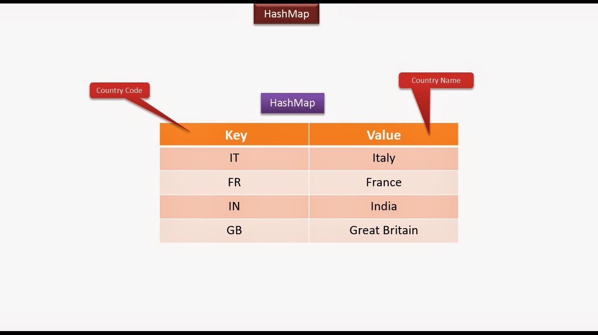
The Map Interface
It is not child interface of Collection interface but has methods similar to Collection
A Map is an object that maps keys to values.

Slide 158
The Map Interface
Mainly used for look ups
Map cannot contain duplicate keys.
Each key can map to at most one value.

Slide 159
The Map Interface
The Map interface includes methods for basic operations such as put() , get(), remove(), containsKey(), containsValue(), size() and isEmpty().
It also provides methods for collection views of it’s contents like keySet(),values() and entrySet()

Slide 160
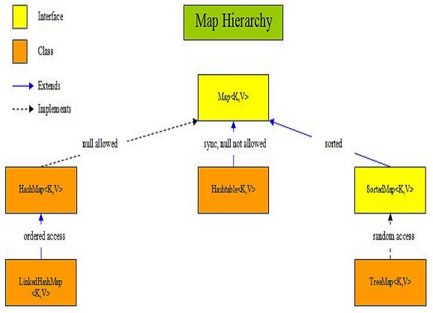
Implementation Classes Of Map

Slide 161
Commonly Used Methods Of Map
void clear( )
Removes all key/value pairs from the invoking map.
boolean containsKey(Object k)
Returns true if the invoking map contains k as a key. Otherwise, returns false.
boolean containsValue(Object v)
Returns true if the map contains v as a value. Otherwise, returns false

Slide 162
Commonly Used Methods Of Map
Set entrySet( )
Returns a Set that contains the entries of the Map. The
set contains objects of type Map.Entry.
This method provides a set-view of the invoking map.
boolean equals(Object obj)
Returns true if obj is a Map and contains the same entries. Otherwise, returns false.
Object get(Object k)
Returns the value associated with the key k.

Slide 163
Commonly Used Methods Of Map
boolean isEmpty( )
Returns true if the invoking map is empty. Otherwise, returns false.
Set keySet( )
Returns a Set that contains the keys in the invoking map. This method provides a set-view of the keys in the invoking map.

Slide 164
Commonly Used Methods Of Map
Object put(Object k, Object v)
Puts an entry in the invoking map, overwriting any previous value associated with the key. The key and value are k and v, respectively. Returns null if the key did not already exist. Otherwise, the previous value linked to the key is returned.
Object replace(Object k, Object v)
Replaces the entry for the specified key only if it is currently mapped to some value. Returns the previous value associated with the specified key, or null if there was no mapping for the key

Slide 165
Commonly Used Methods Of Map
Object remove(Object k)
Removes the entry whose key equals k. Returns the previous value associated with key, or null if there was no mapping for key.
Collection values( )
Returns a collection containing the values in the map. This method provides a collection-view of the values in the map.
int size( )
Returns the number of key/value pairs in the map.

Slide 166
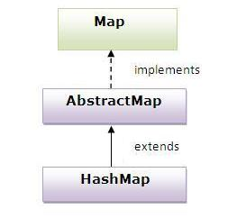
The HashMap class
HashMap class extends AbstractMap and implements Map interface.

Slide 167
The HashMap class
Internally uses HashTable to store the data.
HashMap methods are unsynchornized .
It allows null key and null values

Slide 168
The HashMap class
It is not an ordered collection which means it does not return the keys and values in the same order in which they have been inserted into the HashMap.
It neither does any kind of sorting to the stored keys and Values.
Ensures retrieval of the object on constant time i.e. O(1)

Slide 169
The HashMap Constructors
HashMap( )
This constructs an empty HashMap with the default initial capacity (16) and the default load factor (0.75).
HashMap(int initialCapacity)
Constructs an empty HashMap with the specified initial
capacity and the default load factor (0.75).

Slide 170
The HashMap Constructors
HashMap(int initalCapacity,float loadFactor )
Constructs an empty HashMap with the specified initial capacity and load factor.
HashMap(Map m)
Constructs a new HashMap with the same mappings as
the specified Map.

Slide 171
Program
WAP to store following values in HashMap and print them.
Roll No | Name
101 | Amit
102 | Sumit
103 | Chetan

Slide 172
Program
Now modify the previous code to display only values
Name
Amit
Sumit
Chetan

Slide 173
Using entrySet Method For Traversal
The prototype of the method is :
Set<Map.Entry<K,V>> entrySet()
The method entrySet( ) returns a Set containing objects of the interface Entry defined in Map.

Slide 174
Map.Entry Methods
boolean equals(Object obj)
Returns true if obj is a Map.Entry whose key and value are
equal to that of the invoking object.
Object getKey( )
Returns the key for this map entry.
Object getValue( )
Returns the value for this map entry.

Slide 175
Map.Entry Methods
int hashCode( )
Returns the hash code for this map entry.
Object setValue(Object v)
Sets the value for this map entry to v. A
ClassCastException is thrown if v is not the correct type for
the map. A NullPointerException is thrown if v is null and
the map does not permit null keys. An
UnsupportedOperationException is thrown if the map
cannot be changed.

Slide 176
Program
Rewrite the previous code to display the output as follows:
Roll No
Roll no is …, Name is …
Roll no is …, Name is …
Roll no is …, Name is …

Slide 177
Quiz
Which of these methods deletes all the elements from invoking collection? a) clear() b) reset() c) delete() d) clearAll()
Answer: a) clear( )
Suppose that you would like to create an instance of a new Map that has an iteration order that is the same as the iteration order of an existing instance of a Map. Which concrete implementation of the Map interface should be used for the new instance?
a)TreeMap
b).HashMap
c).LinkedHashMap
Answer: c) LinkedHashMap

Slide 178
Quiz
3. Tell the output
import java.util.*;
class stack {
public static void main(String args[]) {
Stack obj = new Stack();
obj.push(new Integer(3));
obj.push(new Integer(2));
obj.pop();
obj.push(new Integer(5));
System.out.println(obj);
}
}
a) [3, 5]
b) [3, 2]
c) [3, 2, 5]
d) [3, 5, 2]
Answer: a) [3,5]

Slide 179
Quiz
.Which collection class allows you to grow or shrink its size and provides indexed access to its elements, but whose methods are not synchronized?
a)java.util.HashSet
b)java.util.LinkedHashSet
c)java.util.List
d)java.util.ArrayList
Answer: d) java.util.ArrayList

Slide 180
Quiz
5 . You need to store elements in a collection that guarantees that no duplicates are stored and all elements can be accessed in natural order. Which interface provides that capability?
a)java.util.Map
b)java.util.Set
c)java.util.List
d)java.util.Collection
Answer: b) java.util.Set

Slide 181
Quiz
6 . Which collection class allows you to access its elements by associating a key with an element's value, and provides synchronization?
a)java.util.SortedMap
b)java.util.TreeMap
c)java.util.TreeSet
d)java.util.Hashtable
Answer: d) java.util.Hashtable

Slide 182
Quiz
class Test1 {
public int value;
public int hashCode() { return 42; } }
class Test2 {
public int value;
public int hashcode() { return (int)(value^5); } }
a) class Test1 will not compile.
b) The Test1 hashCode() method is more efficient than the Test2
hashCode()method.
c) The Test1 hashCode() method is less efficient than the Test2
hashCode()method.
d) class Test2 will not compile.
Answer: c)

Slide 183
Quiz
8 What two statements are true about properly overridden hashCode() and equals()methods?
1) hashCode() doesn't have to be overridden if equals() is.
2) equals() doesn't have to be overridden if hashCode() is.
3) hashCode() can always return the same value, regardless of the object that invoked it.
4) equals() can be true even if it's comparing different objects.
a)1 and 2
b) 2 and 3
c) 3 and 4
d) 1 and 4
Answer: c)

Slide 184
Quiz
9 Which two statements are true about comparing two instances of the same class, given that the equals() and hashCode() methods have been properly overridden?
If the equals() method returns true, the hashCode() comparison == must return true.
2) If the equals() method returns false, the hashCode() comparison != must return true.
3) If the hashCode() comparison == returns true, the equals() method must return true.
4) If the hashCode() comparison == returns true, the equals() method might return true.
a)1 and4
b) 2 and 3
c) 3 and 4
d) 1 and 3
Answer:a)

Slide 185
Quiz
10 Which of the following are true statements?
1.The Iterator interface declares only three methods: hasNext, next andremove.
2.The ListIterator interface extends both the List and Iterator interfaces.
3.The ListIterator interface provides forward and backward iteration capabilities.
4.The ListIterator interface provides the ability to modify the List during iteration.
5.The ListIterator interface provides the ability to determine its position in the List.
a) 2, 3, 4 and 5
b) 1, 3, 4 and 5
c) 3, 4 and 5
d) 1 ,2 and 3
Answer:b)

Slide 186
How HashMap Works Internally ?
HashMap works on the principal of hashing.
It is a data structure which allows us to store object and retrieve it in constant time O(1) provided we know the key.
HashMap maintains an array of buckets. Each bucket is a linkedlist of key value pairs encapsulated as Entry objects

Slide 187
How HashMap Works Internally ?
This array of buckets is called table. Each node of the linked list is an instance of a private class called Entry.
When we call put( ) method, hashcode() method of key object is called so that hash function of map can find a bucket location to store value object

Slide 188
How put( ) methods works ?
First of all, key object is checked for null. If key is null, value is stored in table[0] position. Because hash code for null is always 0.
Then on next step, a hash value is calculated using key’s hash code by calling its hashCode() method.

Slide 189
How put( ) methods works ?
Now indexFor(hash, table.length) function is called to calculate exact index position for storing the Entry object.
Now, as we know that two unequal objects can have same hash code value, so how two different objects will be stored in same array location [called bucket] ?
Answer is LinkedList.

Slide 190
How put( ) methods works ?
Entry objects are stored in LinkedList form.
When an Entry object needs to be stored in particular index, HashMap checks whether there is already an entry?? If there is no entry already present, Entry object is stored in this location.

Slide 191
How put( ) methods works ?
If there is already an object sitting on calculated index, its next attribute is checked.
If it is null, and current Entry object becomes next node in LinkedList. If next variable is not null, procedure is followed until next is evaluated as null.

Slide 192
How put( ) methods works ?
If we add the another value object with same key as entered before , it replaces the old value.
How it is done?

Slide 193
How put( ) methods works ?
Actually after determining the index position of Entry object, while iterating over LinkedList on calculated index, HashMap calls equals( ) method on key object for each Entry object.
All these Entry objects in LinkedList will have similar hash code but equals() method will test for true equality.
If key.equals(k) will be true then both keys are treated as same key object. This will cause the replacing of value object inside Entry object only.

Slide 194
How put( ) methods works ?
But the hashcode which we get from the hashCode( ) method cannot be used as an index in the bucket.
To solve this issue, HashMap uses another function called hash() function, and passes the object’s hash code to this hash() function to bring hash value in range of array index size.

Slide 195
How get( ) methods works ?
The way key uniqueness is determined in put() method , same logic is applied in get() method also.
The moment HashMap identify exact match for the key object passed as argument, it simply returns the value object stored in current Entry object.

Slide 196
Conclusions
Data structure to store Entry objects is an array named table of type Entry.
A particular index location in array is referred as bucket, because it can hold the first element of a LinkedList of Entry objects.
Key object’s hashCode() is required to calculate the index location of Entry object.
Key object’s equals() method is used to maintain uniqueness of Keys in map.

Slide 197
Conclusions
Value object’s hashCode() and equals() method are not used in HashMap’s get() and put() methods.
Hash code for null keys is always zero, and such Entry object is always stored in zero index in Entry[].
If two key objects have same hashcode, then they will always go to same index in table array.
If two key objects do not have same hashcode then they may or may not go to same index in table array.

Slide 198
Enhancements Done By Java 8
There is a performance improvement for HashMap objects done by java 8.
Once the number of items in a hash bucket grows beyond a certain threshold, that bucket will switch from using a linked list of entries to a balanced tree.
In the case of high hash collisions, this will improve worst-case performance from O(n) to O(log n).
This threshold value is TREEIFY_THRESHOLD = 8

Slide 199
Popular Interview Questions
What is the requirement for an object to be used as key in HashMap?
The key object must implement equals() and hashcode()method.
The hashcode() is used when we insert the key object into the map while equals() is used when we try to retrieve a value based on key from the map.

Slide 200
Popular Interview Questions
What is the requirement for an object to be used as value in HashMap?
The value object must implement equals()method.

Slide 201
Popular Interview Questions
What will happen if you try to store a key which is already present in HashMap?
If we store an existing key in the HashMap, then it will override the old value with the new value and put() will return the old value.
There will not be any exception or error.

Slide 202
Popular Interview Questions
Can you store a null key in Java HashMap?
Yes, HashMap allows one null key, which is stored at the first location of bucket array e.g., bucket[0] = value.
Why null is always stored at location 0 ?
The HashMap doesn't call hashCode() on the null key because it will throw NullPointerException, hence when a user call get() method with null, then the value of the first index is returned.

Slide 203
Popular Interview Questions
How does HashMap handle collisions in Java?
The java.util.HashMap uses chaining to handle collisions, which means new entries, are stored in a linked list along with the existing value, and then that linked list is stored in the bucket location.
In the worst case, where all key has the same hashcode, our hash table will be turned into a linked list, and searching a value will take O(n) time as opposed to O(1) time.

Slide 204
Popular Interview Questions
Which data structure HashMap represents?
The HashMap is an implementation of hash table data structure, which is idle for mapping one value to other like id to name as we can search for value in O(1) time if we have the key.

Slide 205
Popular Interview Questions
Can you explain what is this Hash Table ?
Even though HashMap represents a hash table, it is internally implemented by using an array and linked list data structure in JDK.
The array data structure is used as a bucket, while the linked list is used to store all mappings which land in the same bucket.
From Java 8 onwards, the linked list is dynamically replaced by binary search tree, once a number of elements in the linked list cross a certain threshold to improve performance.

Slide 206
Popular Interview Questions
Is HashMap thread-safe in Java?
No, HashMap is not thread-safe in Java.
We should not share a HashMap with multiple threads if one or more thread is modifying the HashMap e.g., inserting or removing an entry.
Though, we can easily share a read-only HashMap.

Slide 207
Popular Interview Questions
How do you create a read only HashMap ?
A read-only HashMap means a HashMap where we can not perform modification operations like put(), remove() or replace().
We can only read from the Map by using get() method or by using Iterator of Map.
In Java, we can use Collections.unModifiableMap() method to create a read-only HashMap.
Any modification in the read-only Map will result in java.lang.UnSupportedOperationException

Slide 208
Popular Interview Questions
Map<String, String> players = new HashMap<String, Integer>();
players.put("Rohit", 200);
//Map is not read only yet, we can still add entries into
players.put("Virat", 220);
System.out.println("Map in Java before making read only: " + players);
//Making Map read only in Java
Map readOnlyMap = Collections.unmodifiableMap(players);
//We can not put a new entry in read only Map in Java
readOnlyMap.put("Shikhar", 190); //java.lang.UnSupportedOperation
//We can not remove keys from read only Map in Java
readOnlyMap.remove("Virat"); //java.lang.UnSupportedOperation

Slide 209
Popular Interview Questions
What will happen if you use HashMap in a multithreaded Java application?
If we use HashMap in a multithreaded environment in such a way that multiple threads structurally modify the map like add, remove or modify mapping, then the internal data structure of HashMap may get corrupt like some links may go missing, some may point to incorrect entries, and the map itself may become completely useless.
Hence, it is advised not to use HashMap in the concurrent application; instead, we should use a thread-safe map e.g., ConcurrentHashMap or Hashtable.

Slide 210
Popular Interview Questions
In which order mappings are stored in HashMap?
Random order , because HashMap doesn't provide any ordering guarantee for keys, values, or entries.

Slide 211
Popular Interview Questions
How do you sort HashMap in Java? (answer)
We cannot sort a HashMap because unlike List, it is not an ordered collection.
However, we can sort contents of HashMap by keys, values, or by entries by sorting and then storing the result into an ordered map like LinkedHashMap or a sorted map e.g., TreeMap.

Slide 212
Popular Interview Questions
Sort the following HashMap based on runs scored in descending order:
Map<String,Integer>players=new HashMap<>();
players.put("rohit",150);
players.put("virat",200);
players.put("shikhar",120);
players.put("kedar",140);

Slide 213
Popular Interview Questions
class SortMap {
public static void main(String[] args) {
Map<String,Integer>players=new HashMap<>();
players.put("rohit",150);
players.put("virat",200);
players.put("shikhar",120);
players.put("kedar",140);
System.out.println("Before sorting");
for(Map.Entry<String,Integer> e:players.entrySet())
{
System.out.println(e);
}

Slide 214
Popular Interview Questions
LinkedList <Map.Entry<String,Integer>> playersList=new LinkedList<>(players.entrySet());
Collections.sort(playersList, new MyComparator());
LinkedHashMap <String,Integer> sortedPlayers=new LinkedHashMap<>();
for(Map.Entry<String,Integer> e:playersList)
{
sortedPlayers.put(e.getKey(),e.getValue());
}
System.out.println("After sorting");
for(Map.Entry<String,Integer> e:sortedPlayers.entrySet())
{
System.out.println(e);
}
}
}

Slide 215
Popular Interview Questions
class MyComparator implements Comparator
{
@Override
public int compare(Object t1, Object t2) {
Map.Entry<String,Integer>p1=(Map.Entry<String,Integer>)t1;
Map.Entry<String,Integer>p2=(Map.Entry<String,Integer>)t2;
return p2.getValue().compareTo(p1.getValue());
}
}

Slide 216
Popular Interview Questions
How does resizing happens in HashMap?
The resizing happens when the map becomes full or when the size of the map crosses the load factor.
For example, if the load factor is 0.75 and then becomes more than 75% full, then resizing triggers, which involves an array copy.
First, the size of the bucket is doubled, and then old entries are copied into a new bucket.

Slide 217
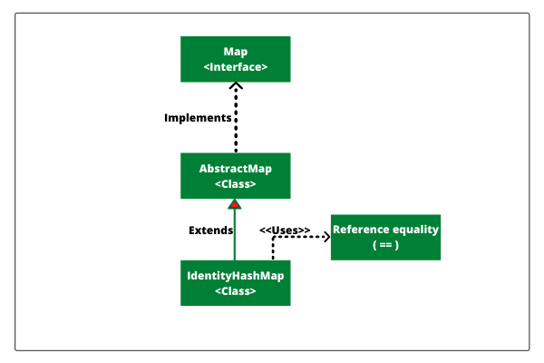
The IdentityHashMap class
IdentityHashMap class extends AbstractMap and implements Map interface.

Slide 218
The IdentityHashMap class
It is similar to HashMap except that it uses reference equality when comparing elements.
This class is not a general-purpose Map implementation.
While this class implements the Map interface, it intentionally violates Map's general contract, which mandates the use of the equals( ) method when comparing objects.

Slide 219
The IdentityHashMap Example
class Age
{
public final Integer val;
public Age(Integer val)
{
this.val = val;
}
@Override
public int hashCode()
{ return val.hashCode();
}

Slide 220
The IdentityHashMap Example
@Override
public boolean equals(Object obj)
{
return this.val.equals(((Age) obj).val);
}
}

Slide 221
The IdentityHashMap Example
public static void main(String[] args)
{
Map map = new HashMap();
map.put(new Age(7), "seven");
System.out.println("One Element added: Size is " +
map.size());
Age age7 = new Age(7);
map.put(age7, "seven Again");
System.out.println("Two Elements added: Size is " +
map.size());

Slide 222
The IdentityHashMap Example
map.put(new Age(7), "Seven a Third time");
System.out.println("Three Elements added: Size is " +
map.size());
System.out.println("Value recovered For 7 is : [ " +
map.get(age7) + " ]");
} }
Output:
One Element added: Size is 1
Two Elements added: Size is 1
Three Elements added: Size is 1
Value recovered For 7 is : [ Seven a Third time ]

Slide 223
The IdentityHashMap Example
Now if we repalce the HashMap object with
IdentityHashMap object and run the same code
Map map = new IdentityHashMap();
Then the output will be:
One Element added: Size is 1
Two Elements added: Size is 2
Three Elements added: Size is 3
Value recovered For 7 is : [ seven Again ]

Slide 224
IdentityHashMap V/s HashMap class
Main difference between HashMap vs IdentityHashMap is that IdentityHashMap uses equality operator "==" for comparing keys and values inside Map while HashMap uses equals( ) method for comparing keys and values.
Unlike HashMap, who uses hashcode( ) to find bucket location, IdentityHashMap doesn't use hashCode() instead it uses System.identityHashCode(object).

Slide 225
IdentityHashMap V/s HashMap class
Another key difference between IdentityHashMap and HashMap in Java is Speed.
Since IdentityHashMap doesn't use equals() its comparatively faster than HashMap for object with expensive equals() and hashCode().

Slide 226
The WeakHashMap Class
WeakHashMap is an implementation of the Map interface that stores only weak references to its keys.
Storing only weak references allows a key-value pair to be garbage collected when its key is no longer referenced outside of the WeakHashMap.

Slide 227
The WeakHashMap Class
Map hashMap= new HashMap();
Map weakHashMap = new WeakHashMap();
String keyHashMap = new String("keyHashMap");
String keyWeakHashMap = new
String("keyWeakHashMap");

Slide 228
The WeakHashMap Class
hashMap.put(keyHashMap, “Sachin");
weakHashMap.put(keyWeakHashMap, "Amit");
System.out.println("Before: hash map value:"+hashMap.get("keyHashMap")+" and weak hash map value:"+weakHashMap.get("keyWeakHashMap"));

Slide 229
The WeakHashMap Class
keyHashMap = null;
keyWeakHashMap = null;
System.gc();
System.out.println("After: hash map value:"+hashMap.get("keyHashMap")+" and weak hash map value:"+weakHashMap.get("keyWeakHashMap"));

Slide 230
The WeakHashMap Class
Output:
Before: hash map value:Sachin and weak hash map value:Amit
After: hash map value:Sachin and weak hash map value:null

Slide 231
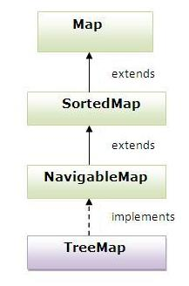
The TreeMap class
TreeMap class extends AbstractMap and implements NavigableMap interface.

Slide 232
The TreeMap class
Internally uses Balanced Binary Tree to store the data.
Contains values based on the key.
It implements the NavigableMap interface and extends AbstractMap class.
It provides guaranteed log(n) time cost for the containsKey, get, put and remove operations

Slide 233
The TreeMap class
It contains only unique elements.
It cannot have null key but can have multiple null values.
It is same as HashMap instead it maintains data in ascending order.

Slide 234
The TreeMap Constructors
TreeMap( )
Constructs a new, empty tree map, using the natural ordering of its keys. All keys inserted into the map must implement the Comparable interface.
TreeMap(Comparator)
Constructs a new, empty tree map, ordered according to the given Comparator

Slide 235
The TreeMap Constructors
TreeMap(Map)
Constructs a new tree map containing the same mappings as the given map, ordered according to the natural ordering of its keys. All keys inserted into the new map must implement the Comparable interface
TreeMap(SortedMap)
Constructs a new tree map containing the same mappings
and using the same ordering as the specified SortedMap

Slide 236
The Queue Interface
The java.util.Queue interface is a subtype of the java.util.Collection interface.
It represents an ordered list of objects just like a List but with a slight difference.

Slide 237
The Queue Interface
It supports the ordering of elements in a first-in-first-out (FIFO) basis.
FIFO means that the element first added will be the first we get when retrieving elements.
This is in contrast to a List in which we can choose which element to retrieve by passing an index to its get() method.

Slide 238
The Queue Interface Methods
Besides basic Collection operations, queues provide additional insertion, removal, and inspection operations.
public interface Queue<E> extends Collection<E>
{
E element();
boolean offer(E e);
E peek();
E poll();
E remove();
}

Slide 239
Two Forms Of Methods
Each Queue method exists in two forms:
(1) one throws an exception if the operation fails, and
(2) the other returns a special value if the operation fails (either null or false, depending on the operation).

Slide 240
Two Forms Of Methods
Type of Operation | Throws exception | Returns special value
Insert | add(e) | offer(e)
Remove | remove() | poll()
Examine | element() | peek()

Slide 241
Method Description ( add() v/s offer( ))
The add() method, which Queue inherits from Collection, inserts an element unless it would violate the queue's capacity restrictions, in which case it throws IllegalStateException.
The offer() method, which is intended solely for use on bounded queues, differs from add() only in that it indicates failure to insert an element by returning false.

Slide 242
Method Description ( remove() v/s poll( ))
The remove( ) and poll() methods both remove and return the head of the queue.
Exactly which element gets removed is a function of the queue's ordering policy.
The remove() and poll() methods differ in their behavior only when the queue is empty.
Under these circumstances the method remove( ) throws NoSuchElementException, while poll() returns null.

Slide 243
Method Description (element() v/s peek( ))
The element( ) and peek( ) methods return, but do not remove, the head of the queue.
They differ from one another in precisely the same fashion as remove( ) and poll().
If the queue is empty , then the method element() throws NoSuchElementException, while peek() returns null.

Slide 244
Object Ordering In Queue
Queues typically, but not necessarily, order elements in a FIFO (first-in-first-out) manner.
Among the exceptions are priority queues, which order elements according to their values
Whatever ordering is used, the head of the queue is the element that would be removed by a call to remove() or poll().

Slide 245
Object Ordering In Queue
In a FIFO queue, all new elements are inserted at the tail of the queue.
Other kinds of queues may use different placement rules.
Every Queue implementation must specify its ordering properties.

Slide 246
Bounded and UnBounded Queue
It is possible for a Queue implementation to restrict the number of elements that it holds; such queues are known as Bounded.
While a queue in which there is no upper limit specified is called an UnBounded Queue

Slide 247
Bounded and UnBounded Queue
Some Queue implementations in java.util.concurrent are bounded, but the implementations in java.util are not.
For example java.util.concurrent.ArrayBlockingQueue is a bounded queue , while PriorityQueue available in java.util is Unbounded

Slide 248
Handling of null By Queue
Queue implementations generally do not allow insertion of null elements.
The LinkedList implementation, which was retrofitted to implement Queue, is an exception.
For historical reasons, it permits null elements, but we should refrain from taking advantage of this. WHY ?
because null is used as a special return value by the poll() and peek() methods.

Slide 249
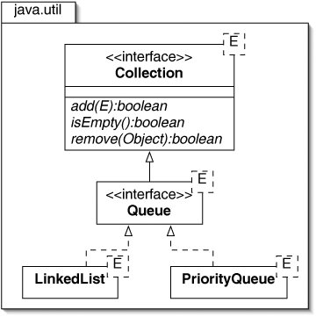
Queue Implementations
Although , Queue has many implementations but the two most popular and common are :
java.util.LinkedList
java.util.PriorityQueue

Slide 250
Queue Implementations
LinkedList is a pretty standard queue implementation.
PriorityQueue stores its elements internally according to their natural order (if they implement Comparable), or according to a Comparator passed to the PriorityQueue.

Slide 251
The LinkedList Class
The LinkedList class is often used to store a list, or queue, of work elements.
It represents tasks waiting to be executed

Slide 252
What Is The Output ?
Queue <String>myQueue = new LinkedList<>();
myQueue.offer("Monday");
myQueue.offer("Tuesday");
boolean flag = myQueue.offer("Wednesday");
System.out.println("Wednesday inserted successfully?
"+flag);

Slide 253
What Is The Output ?
try {
myQueue.add("Thursday");
myQueue.add("Friday");
myQueue.add("Weekend");
}
catch (IllegalStateException e)
{
e.printStackTrace();
}
System.out.println("Pick the head of the queue: " + myQueue.peek());

Slide 254
What Is The Output ?
String head = null;
try {
head = myQueue.remove();
System.out.print("1) Push out " + head + " from the queue ");
System.out.println("and the new head is now: "+myQueue.element());
}
catch (NoSuchElementException e)
{
e.printStackTrace();
}

Slide 255
What Is The Output ?
head = myQueue.poll();
System.out.print("2) Push out " + head + " from the queue");
System.out.println("and the new head is now: "+myQueue.peek());
System.out.println("Does the queue contain 'Weekend'? " + myQueue.contains("Weekend"));
System.out.println("Does the queue contain 'Monday'? " + myQueue.contains("Monday"));

Slide 256
Output
Wednesday inserted successfully? true
Pick the head of the queue: Monday
1) Push out Monday from the queue and the new head is now: Tuesday
2) Push out Tuesday from the queueand the new head is now: Wednesday
Does the queue contain 'Weekend'? true
Does the queue contain 'Monday'? false

Slide 257
The PriorityQueue Class
PriorityQueue class was introduced in Java 1.5 and part of Java Collections Framework.
PriorityQueue is an unbounded queue based on a priority heap.
The elements of the priority queue are ordered by default in natural order or we can provide a Comparator for ordering at the time of instantiation of queue.

Slide 258
Why We Need PriorityQueue ?
We know that Queue follows First-In-First-Out model but sometimes we need to process the objects in the queue based on the priority.
For example, let’s say we have an application that has to handle the documents sent to the Computer Science Department's printer:
Documents sent by the HOD should be printed first,
Then documents sent by professors,
Then those sent by graduate students, and
Finally those sent by undergraduates

Slide 259
Why We Need PriorityQueue ?
So users are sending request to the application that is actually getting queued but we want to process premium users first and standard users after them.
So in this case PriorityQueue implementation in java can be really helpful.

Slide 260
PriorityQueue Key-Points
A Comparator can be provided in the constructor when instantiating a PriorityQueue. Then the order of the items in the Queue will be decided based on the Comparator provided.
If a Comparator is not provided, then the natural order (Comparable) of the Collection will be used to order the elements.
null is not allowed in this Collection.

Slide 261
PriorityQueue Key-Points
Head of the Queue is the least item in the order.
Ordering ties between the PriorityQueue elements are decided arbitrarily.
PriorityQueue is not synchronized
PriorityBlockingQueue is the thread-safe counterpart of PriorityQueue.

Slide 262
PriorityQueue Key-Points
PriorityQueue is unbounded and it grows dynamically based on the number of elements in the Queue.
It has internal capacity at any given time and it is increased as the elements are added.
The policy for this internal capacity and increment is not specified or standardized.

Slide 263
PriorityQueue Key-Points
The iterator() of this PriorityQueue does not guarantee for traversal of the Queue elements in any particular order.
Performance wise; contains() method take linear time.
peek(), element() and size() takes fixed time.
offer(), poll() and remove() takes O(log n) time.

